Slide 1
Deals And Offers
By – Tejshree Bakore
14/CA/619

Slide 2

Introduction
Deals and Offers was founded with the aim to give the local sellers of India a chance to expand their business all across the country. The main motive here is to allow end-users to sell new products as well as old products on the very same platform.

Slide 3
Project Description
The website is divided under two modules namely- user and admin.
A user will conceptually act as a seller or buyer or both.
The admin performs various tasks like – Blacklisting user, Refunding money, transfering money to sellers and viewing the various reports related to buying and selling of products.

Slide 4
Database Tables
A total of 7 tables were used to convieniently move and save data under various circumstances. The table names are mentioned below :
User master
Admin login
Validate User
Feedback Master
Product master
Order master
Messageboard master

Slide 5
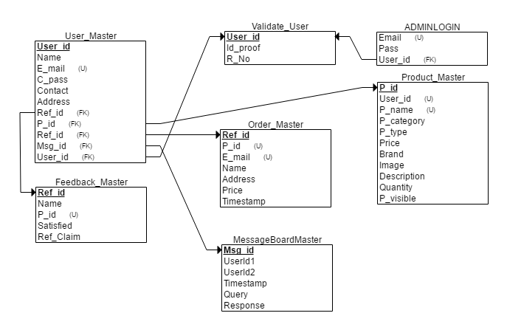
Database Relational Schema

Slide 6
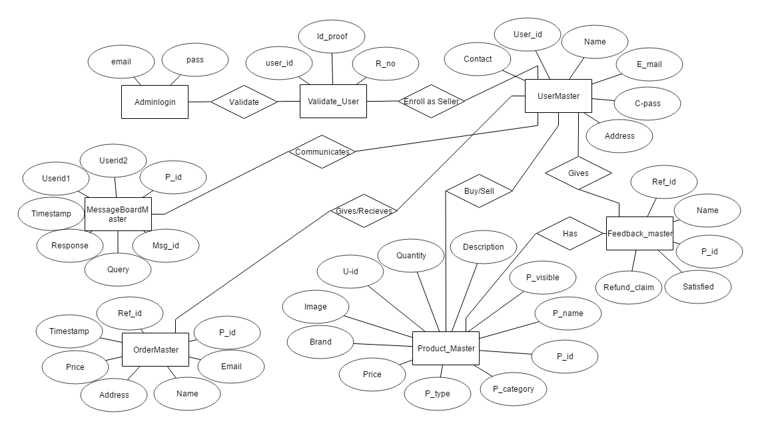
ER-Diagram

Slide 7
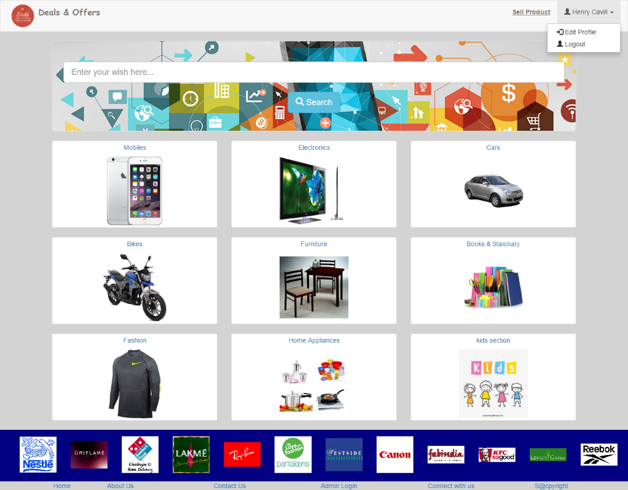
Home Page
The first page a visitor wil see is the home page (or index/master page).
A user can search for any product he desires in the search box provided.
There are various categories available for selection by default.
A user can go by them or can directly search for any product.

Slide 8
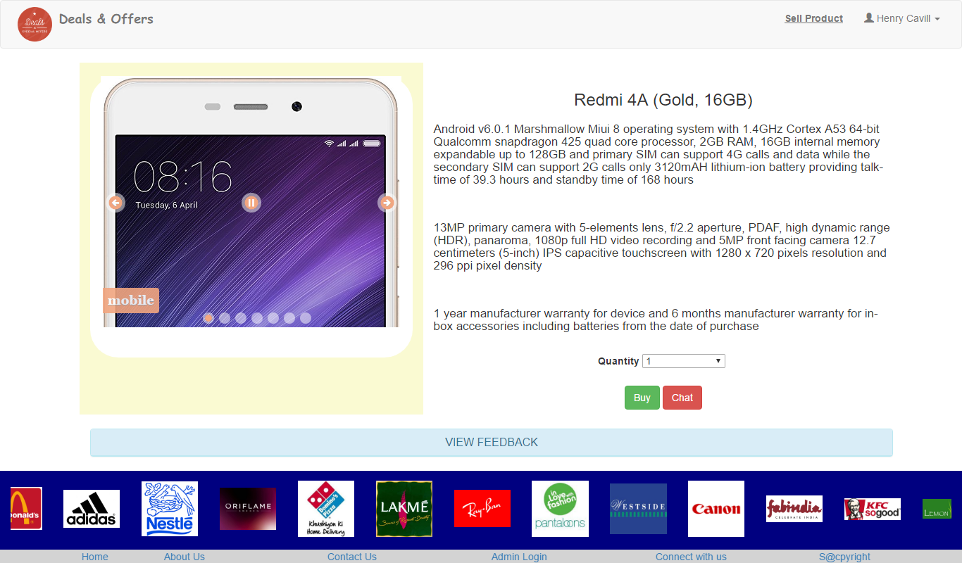
Items Interface
The items interface page is item specific and will hold the description about the product including all the basic details like – Brand, Price, Warranty etc.
The user can contact and communicate with the seller using the chat option provided on every Item Interface page.

Slide 9
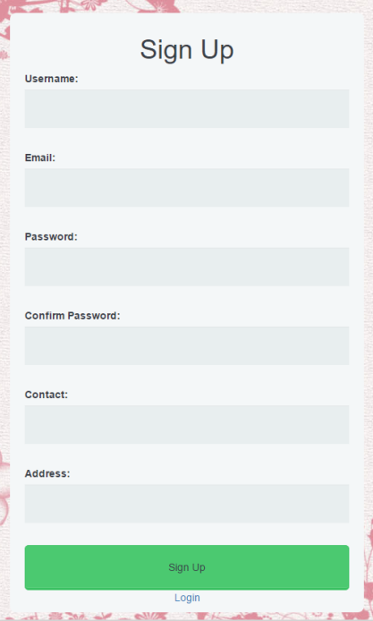
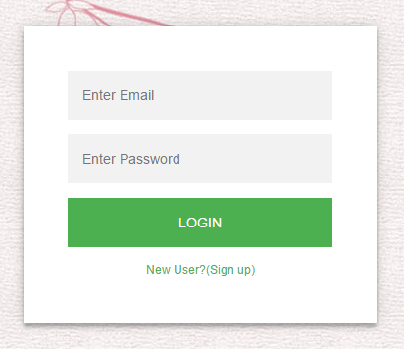
SignUp & Login
The user is supposed to Register before he/she can buy, chat, or sell(new) product.

Slide 10
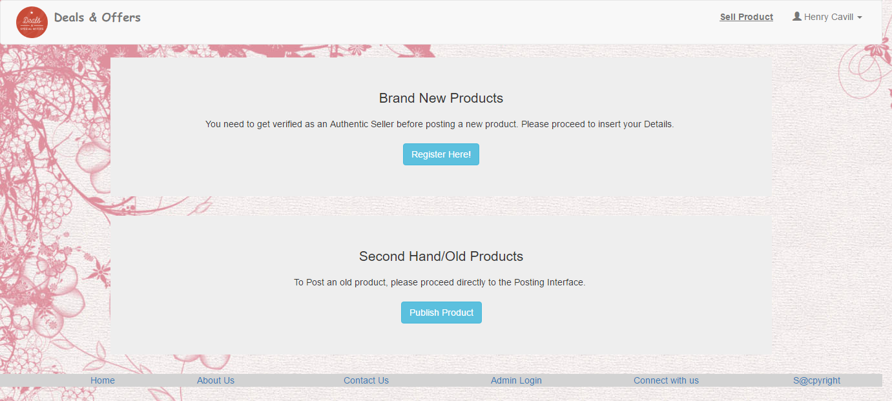
Sell Item Interface

Slide 11
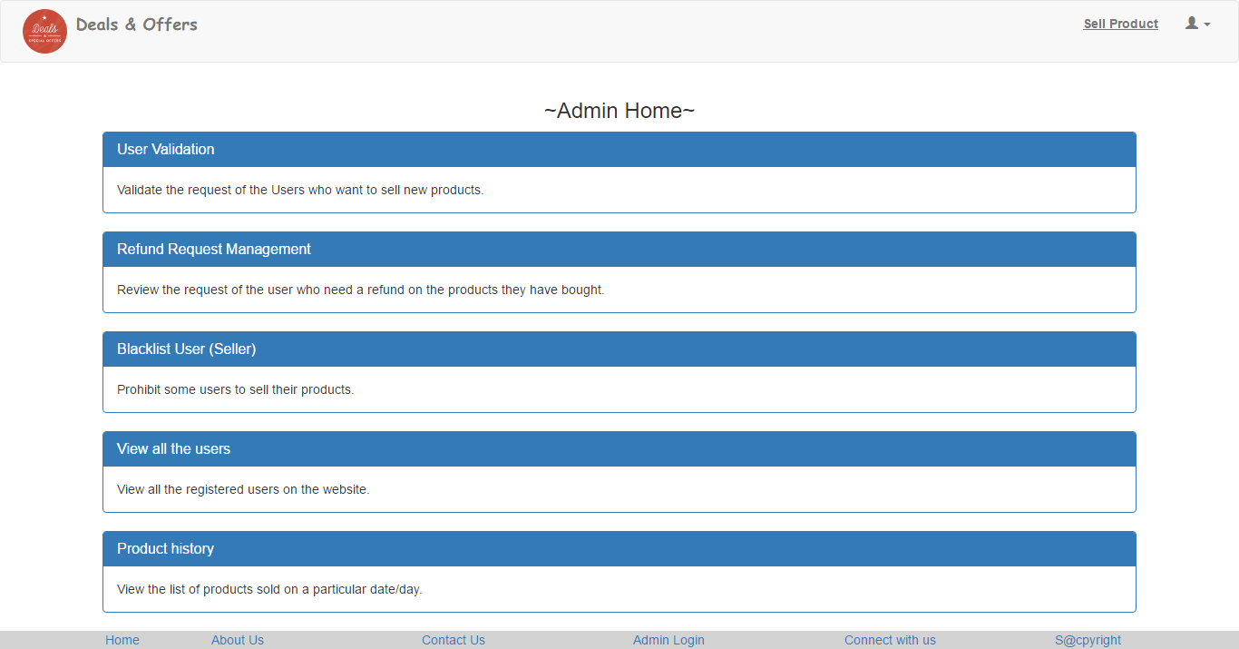
Admin Home
The admin is the prime management administrator of the workplace.
The home page of admin will hold the links to various functions that an admin is supposed to perform.

Slide 12
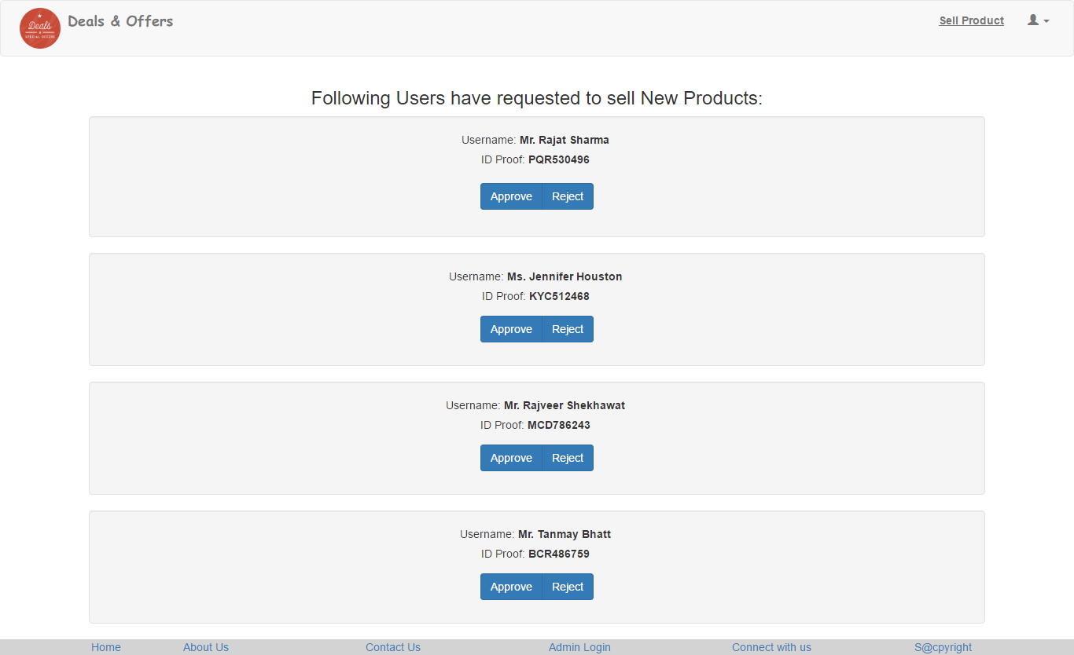
Validate User
The admin needs to verify all the users before a user can sell any new product.
Username and Id-proof information are supplied to admin from the user.

Slide 13
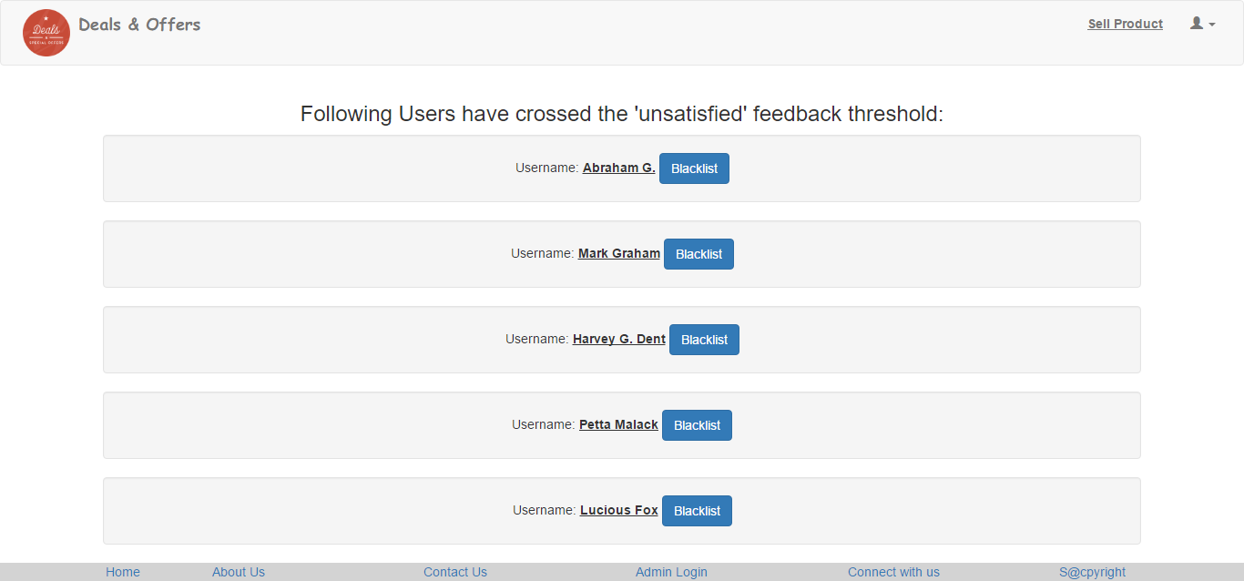
Blacklisting
The admin is capable of blacklisting a Seller. A seller can be blacklisted if he indulges in any sort of malpractices.
Also, when any seller gets more then a certain predecided amount of negative feedbacks, his profile will be reviewed by admin. A customer can be blacklisted as well.

Slide 14
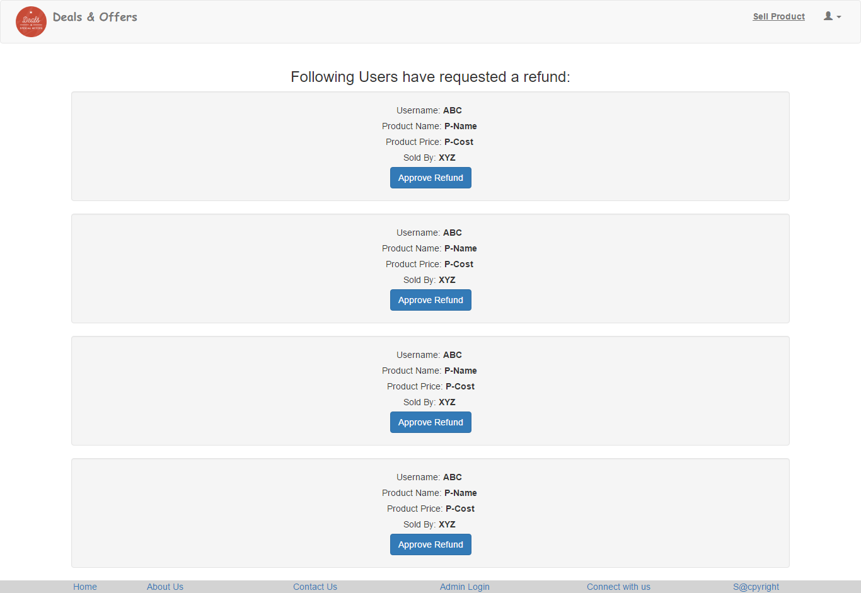
Refund Requests
Only the admin has the privileges to allow for a refund in case the product is not delivered OR not delivered as promised.

Slide 15
Future Scope
Shipping Options: Add different types of shipping options: regular shipping, expedited shipping, international shipping, etc
Recommended Items: Add a bar that would display the most-recommended items which would depend on the number of times an item has been purchased by any users.

Slide 16
Thank You..!

